Slide 1
Turning a PhD into a Book
Professor Terry Gifford
Bath Spa University
Universidad de Alicante

Slide 2
External Examiner for PhDs:
Literary: 17 (1997-2026)
Creative Writing: 5 (2008-2023)
Total: 22
Worked with Editors at:
CUP, OUP, EUP, Routledge, Palgrave Macmillan, Bloomsbury, Brill Rodopi (on the Advisory Board), MUP, Faber and Faber, Peter Lang, Georgia University Press.

Slide 3
Differences
A book is a different animal needing a coherent narrative, a sense of a whole, a provocative engagement, an internal continuity, a less explicit staging of structure, a less defensive tone, a more freewheeling enquiry.
This is a different audience.
So a review of the field, for example, and defining of terms, can be more critical, combative, less respectful, more assertive than tentative/guarded, more dramatically engaging.

Slide 4
Target Publishers
Who publishes books like yours?
Check their lists and publishers of your key citations.
Is there a series you’d like to be part of?
Do you or your supervisor/external examiner have any contacts with potential publishers?
Use the name of the publisher’s Editor for your field.
Don’t neglect US university presses, or European presses like Brill Rodopi.

Slide 5
The Book Proposal
Check out forms from the publishers’ websites.
Ask to see a successful book proposal from a friend or colleague or your supervisor.
You will deal with a publisher’s Editor and series editors who advise the Editor.
It will go to 2 readers who will report and suggest changes. You must respond to all of them, but can argue against some.
Send in a revised proposal to go to the Board.

Slide 6
From Routledge book proposal guidelines:
‘6. Books based on a PhD thesis (if applicable)
• Which parts will you cut or modify?
• How will you draw out and expand the main findings and conclusions?
• What specifically are the aspects of the work as it stands which are designed to satisfy your examiners, but which you think are not suitable for a book and which you plan to change?
• How will you be adapting the language and style, as well, as annotation and references?
• Is the thesis in an area of increasing academic and research interest?’

Slide 7
NB
70,000 words including notes and bibliography.
2 sample chapters as works-in-progress.
Don’t rush for an early deadline for submission.
You will pay for permissions.
You will pay for illustrations.
You will make the Index or be charged for an indexer.
You will be asked to name 6 peer reviewers.

Slide 8
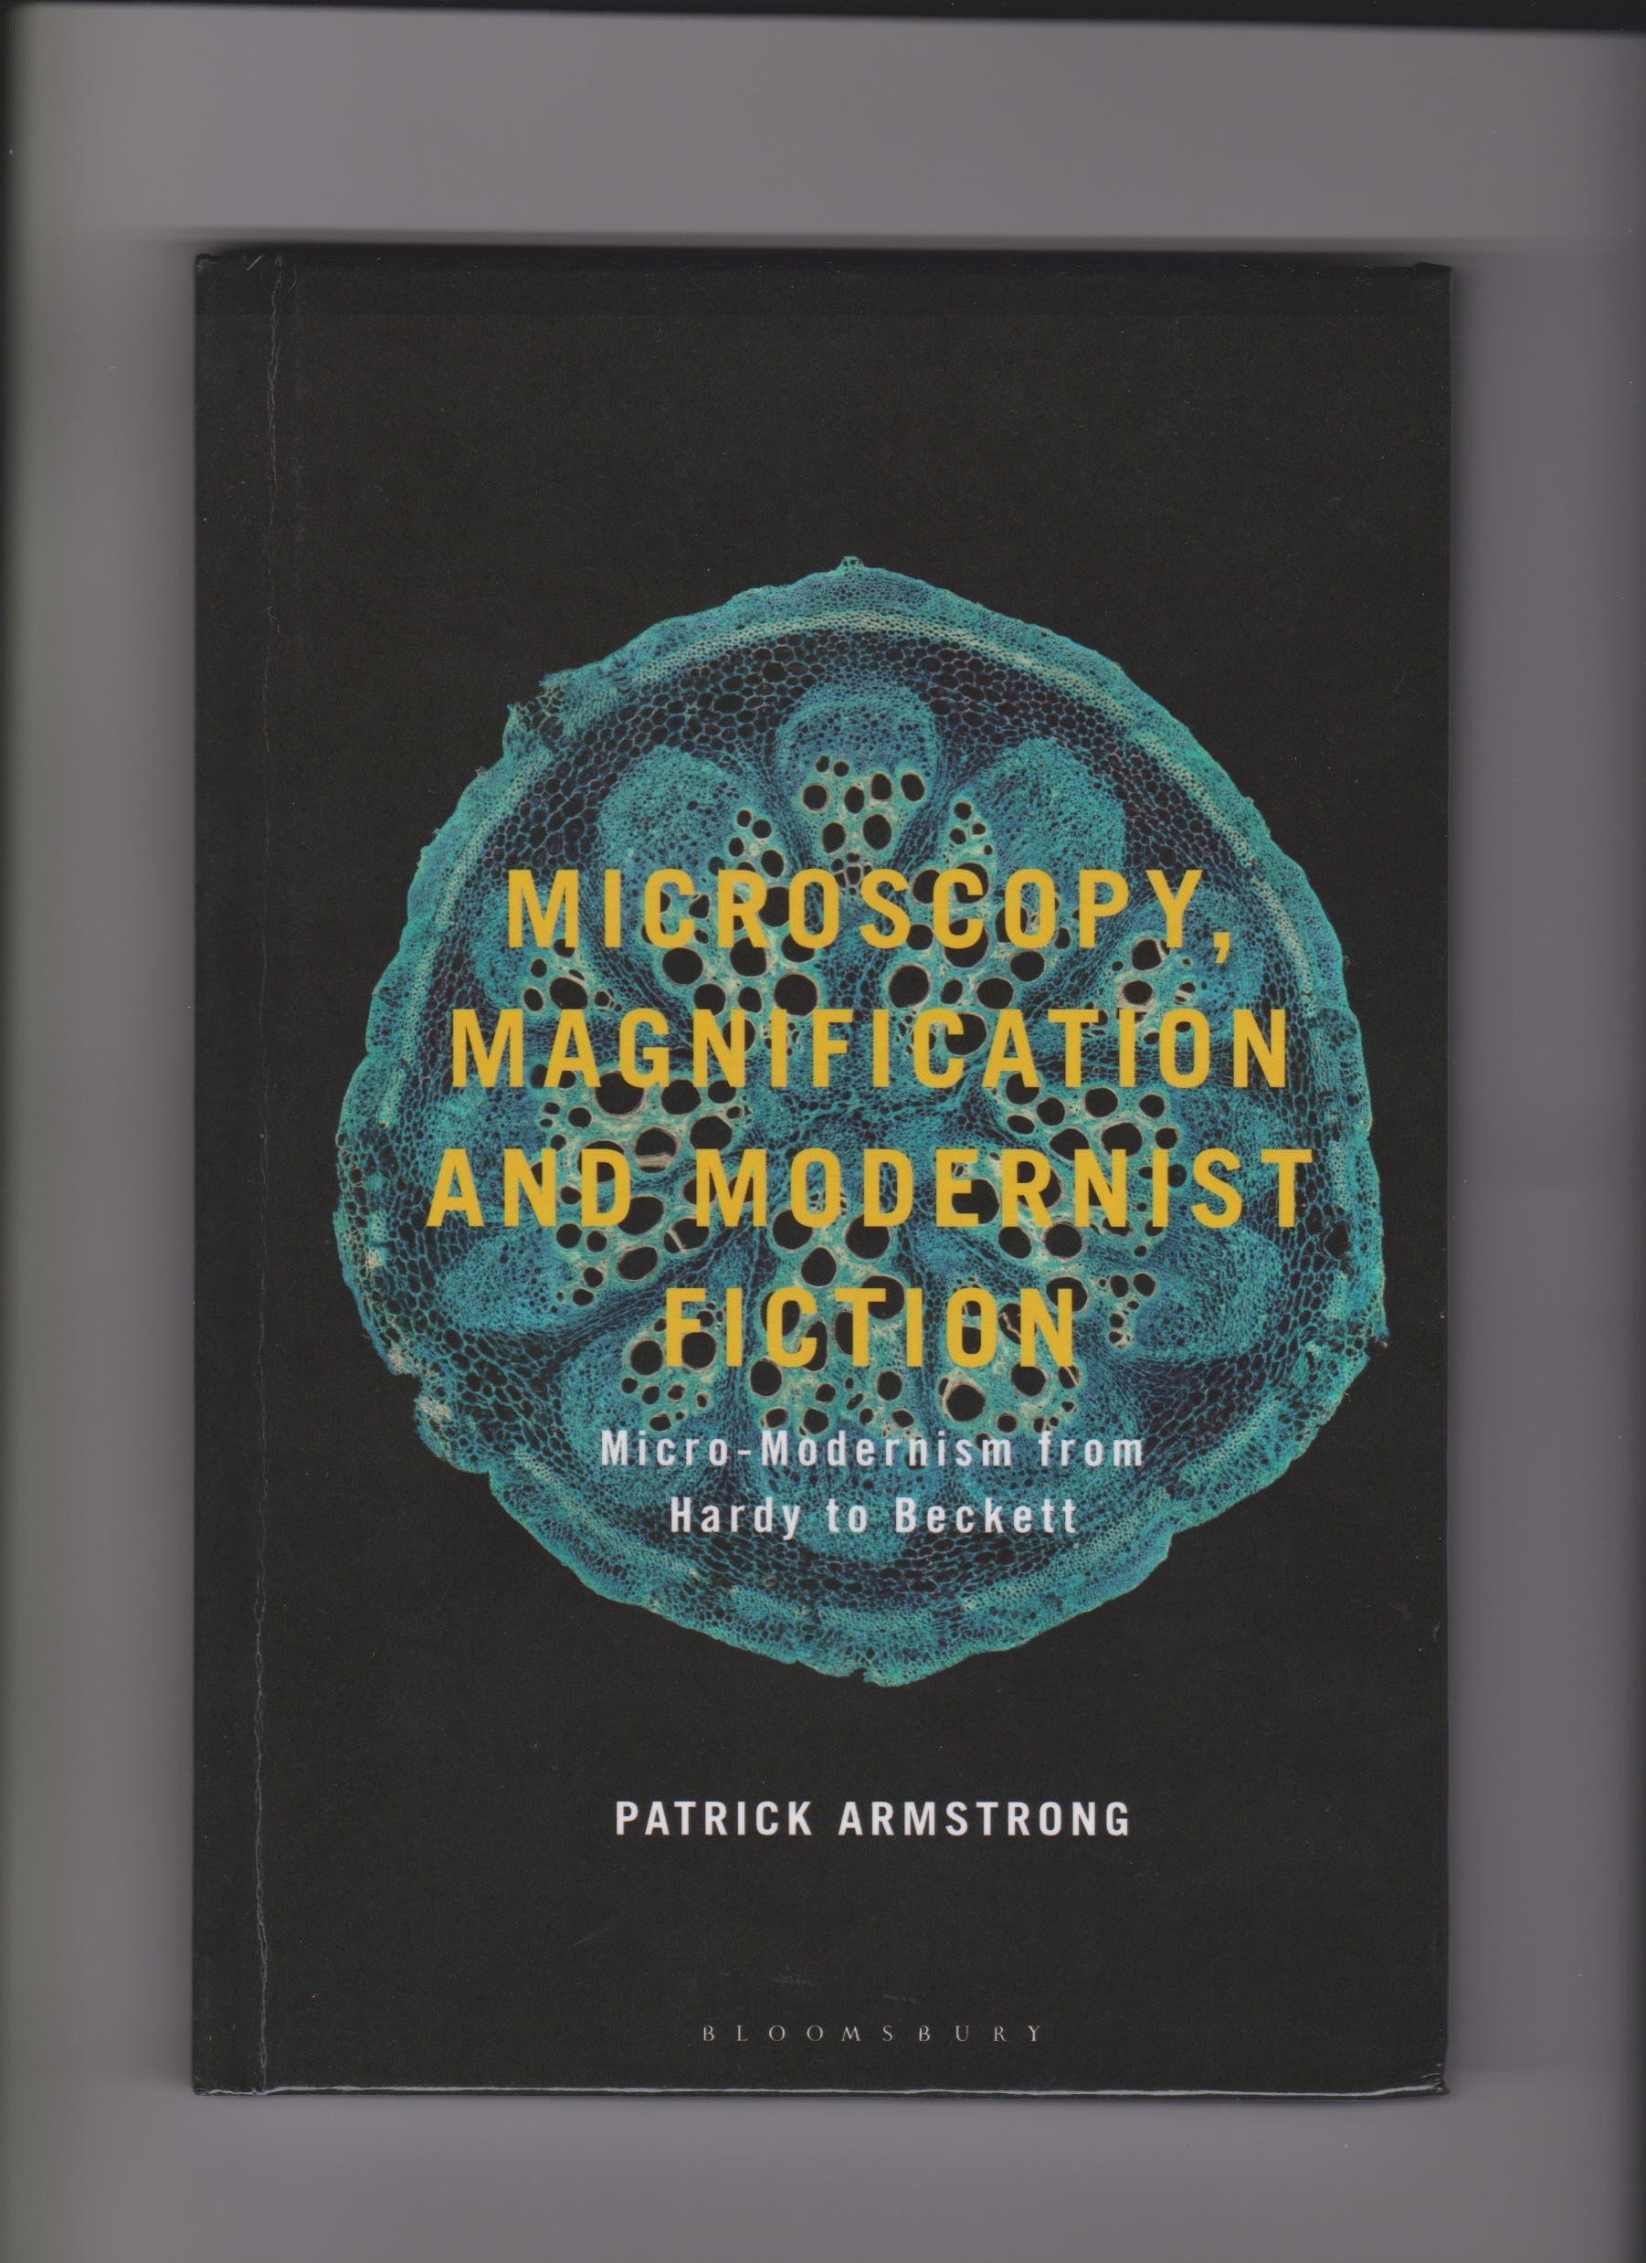

Slide 9
From Patrick Armstrong PhD:
Being more adventurous in writing the Conclusion was definitely one thing. In fact, the Introduction and Conclusion were the parts I did the most work on when turning the PhD into a book, as I attempted to refine and sharpen my arguments. I tried to make bolder claims in both the Intro and Conclusion, and was generally less ‘defensive’ in tone than I had been in my thesis.
I also tried to improve the links between the chapters and the general flow of the book (I was somewhat less concerned with this in my thesis).
Generally, I’d say that I tried to write with more freedom, thinking less about what examiners might raise their eyebrows at and more about how to be thought-provoking and engaging for a wider audience.

Slide 10
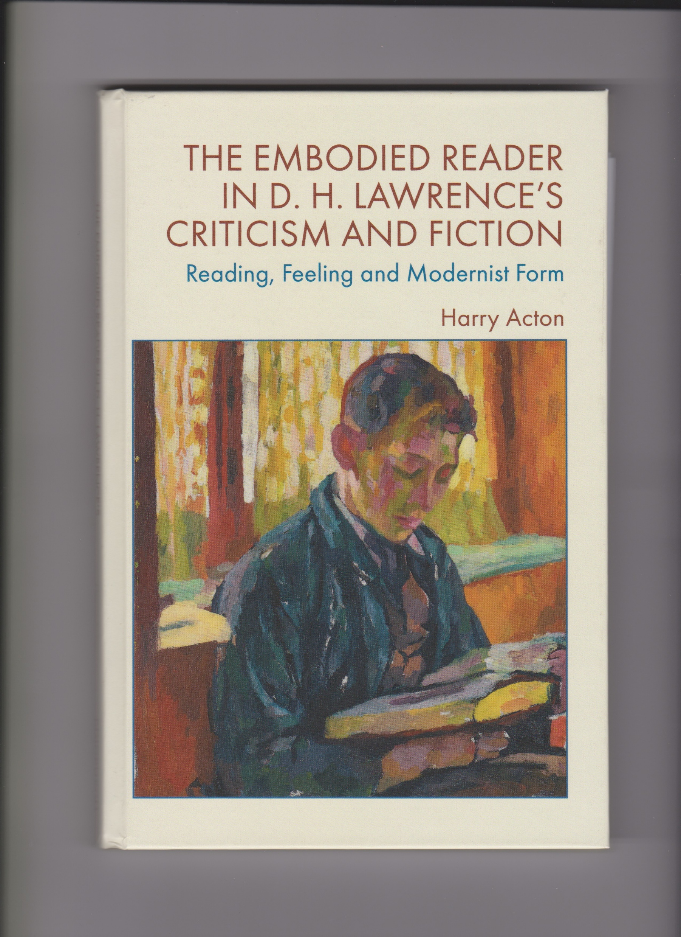

Slide 11
From Harry Acton PhD
I’d say it’s important to be confident that your work is in near-publishable form already. I was lucky here in that my external examiner had said the thesis was ‘very close to publishable’, but I did some rewriting, especially of the Introduction, to link it more closely to current critical debates. That proved a good idea, as both OUP and Edinburgh asked to see the Introduction (along with an official proposal) after I wrote them query letters. But I think that writing a good initial query letter, to introduce yourself and gauge the editor’s interest in the book, is probably what matters most. So two specific bits of advice in relation to that:
1) Think about which publishers already show an interest in your subject and critical approach – in my case, Edinburgh was an obvious choice as they publish some of the most innovative work in modernist studies at the moment, and had recently published a collection on Lawrence (The Edinburgh Companion to D. H. Lawrence and Arts).
2) Write an engaging, concise query letter to the editor you think is most likely to be interested in your project. It’s important to explain why your work would complement their existing lists, as well as what range of readership you aim to engage. For example, I suggested my book would contribute to wider debates about the purposes of criticism and the ‘affective turn’ in Modernist studies, as well as to Lawrence studies.

